Slide 1
Mantid Current Development and other news
Nicholas Draper
Scientific Steering Committee 2014

Slide 2
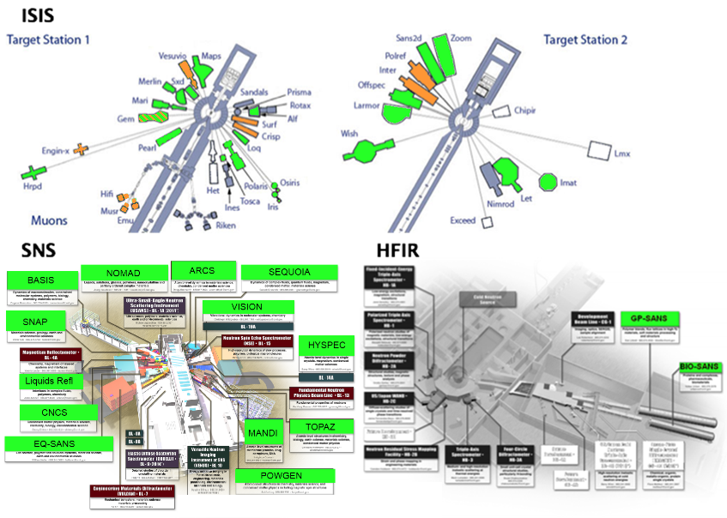
Deployment

Slide 3


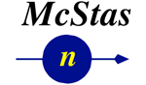
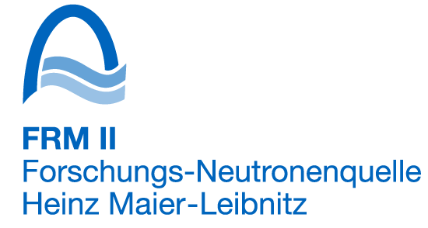

Contributors
NMI3 supported evaluation
IN4,5 & 6
D33
Focus
Lujan Nexus Load algorithm
Improving McStas – Mantid integration
LoadMcStas
TofTof

Slide 4
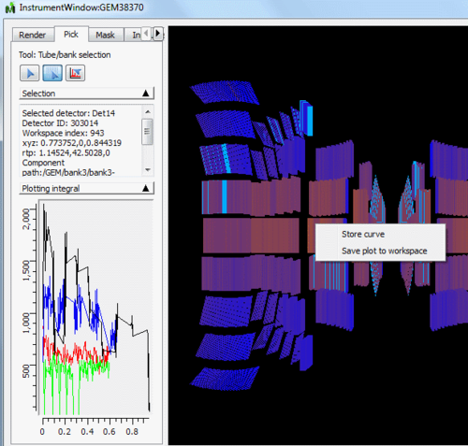
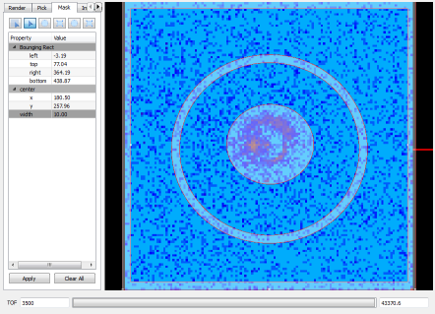
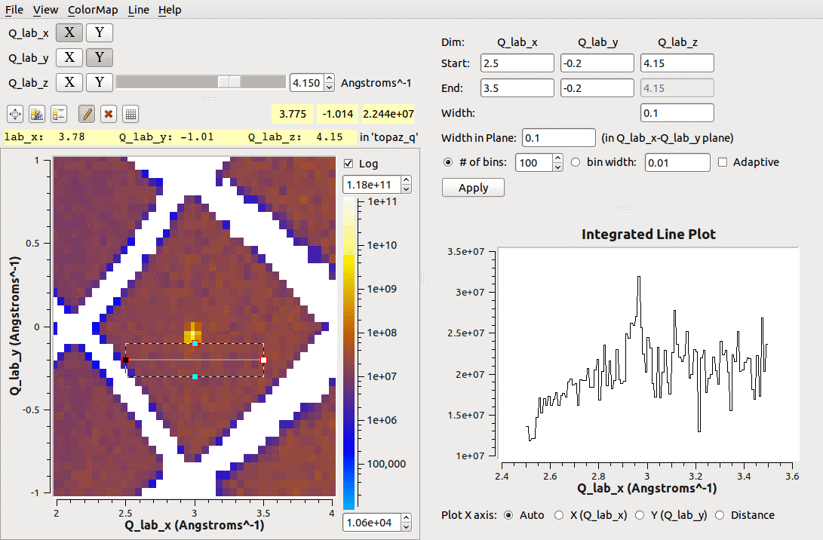
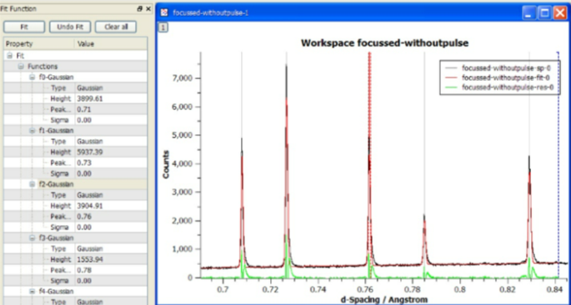
What we can do - Tools

Slide 5
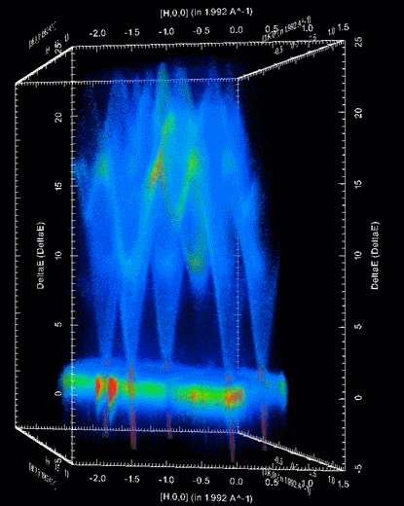
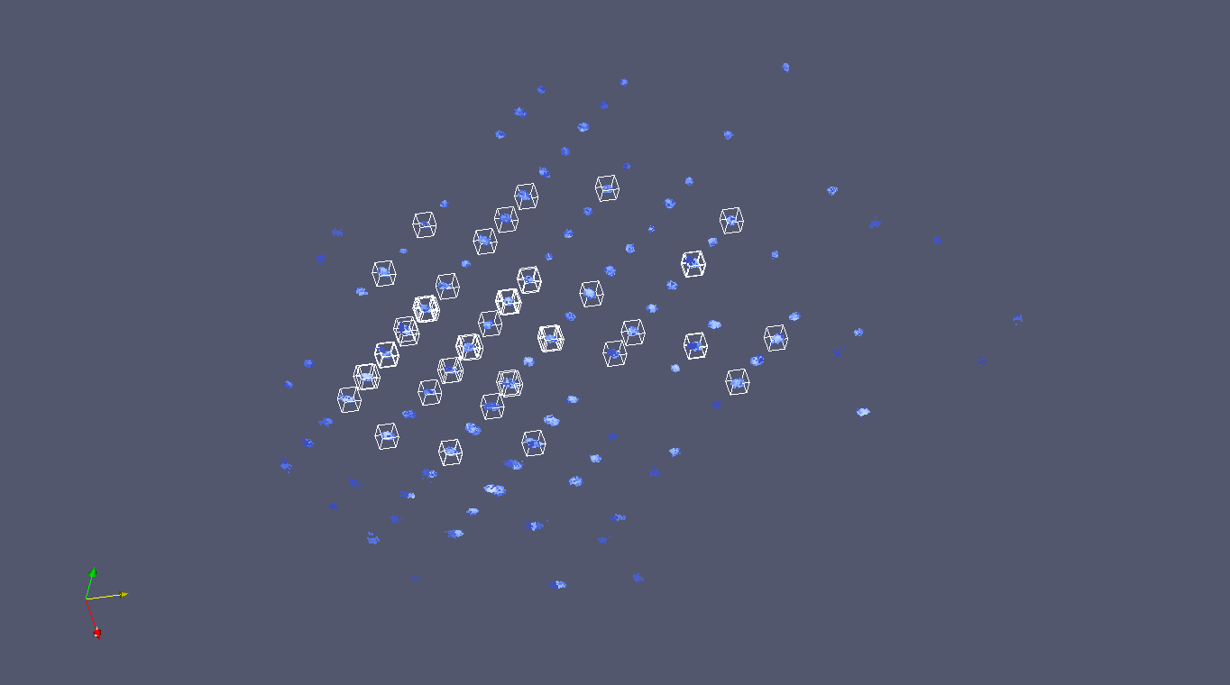
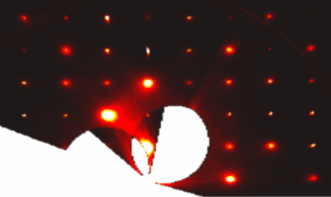
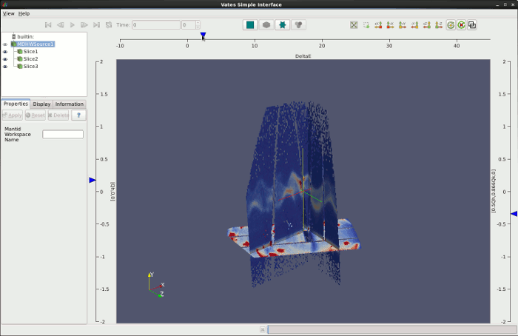
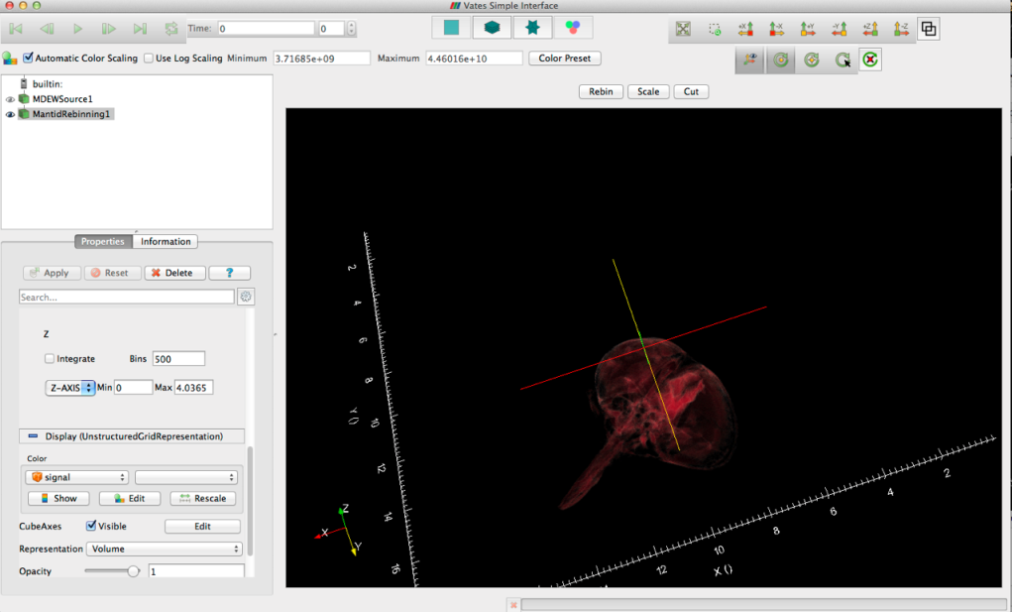
What can we do - Visualization

Slide 6
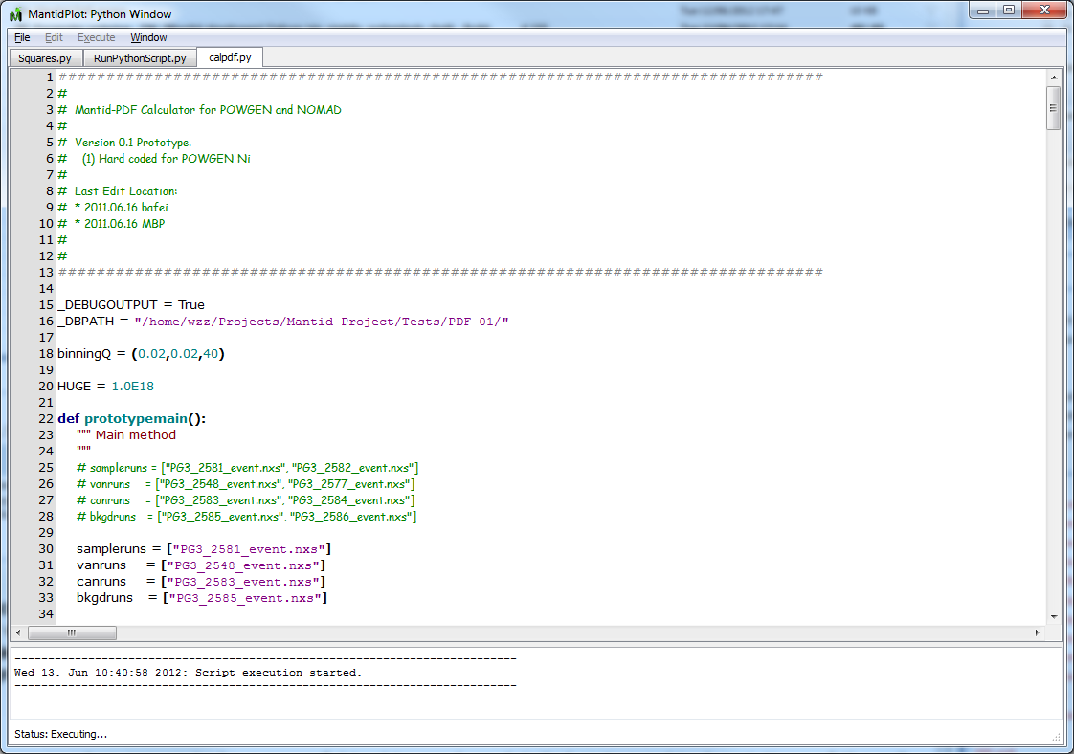
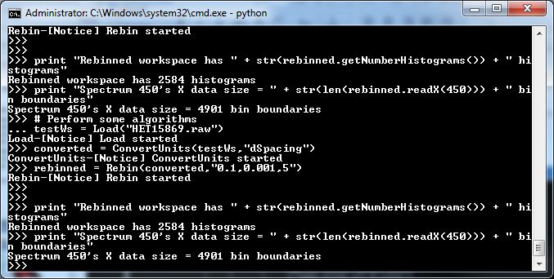
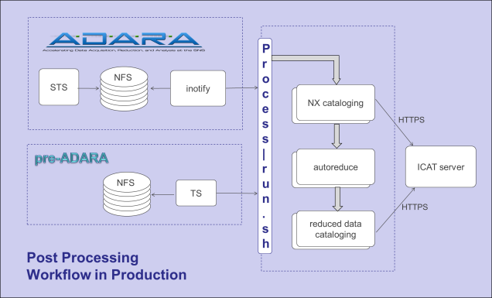
What we can do - Scripting
Python Control
Within MantidPlot or command line
iPython Shell
Integrated numPy
Python Plugins
Algorithms
Fitting functions
User interfaces
Automated reduction

Slide 7
Cleaner Interface
Simplified Tool bar redesign
Instrument View improvements
Default unwrapped views for instruments, side by side view
Improved tools for selection, masking and grouping
Display of guides, choppers etc
Easily see Monitors and details of grouped detectors
Offline Help
New ICAT interface

Slide 8
Framework
File loading improvements
Capability and performance
Curve fitting and optimisation
Stability of back to back exponential curve fitting
Visualization of Structure Factors from Molecular Dynamics Simulations (Sassena integration)
Tube Calibration
Live Data
Parallel reduction

Slide 9
Visualisation
Incorporation of features developed with Kitware
Visualization of non orthogonal data
Ability to provide axis labels from datasets
Ability to provide "time" label from datasets
Allow override of axis extents for displaying original extents
Porting of the MultiSlice view into ParaView proper
QuadView (ThreeSlice) plugin that incorporates coordinate readout and dynamic slice repositioning

Slide 10
Python
Managed removal of Python V1
Adoption of Ipython in all environments as the Mantid script interpreter
Implementation of a Script Library to support user sharing

Slide 11
Inelastic
Direct Inelastic
DGSReduction
Indirect
Many improvements throughout convert to energy and Indirect Data Analysis
Indirect BAYES inteface
Now completely replaces all MODES functionality
FORTRAN modules supported in 32 & 64 bit windows

Slide 12
Large Scale Structures
SANS
Beam centre correction for the High Angle Bank of LOQ and SANS2D
Support for Wide angle corrections
Support for CANSAS v1.1
Reflectometry
Stitch1D created to make stitching 1D data easy
Support for various reflectometry plots

Slide 13
Diffraction
Powder Diffraction
Many improvements to AlignAndFocusPowder
LeBailFit and associated algorithms which can be used to determine an initial FULLPROF parameter file.
Single Crystal
Single Crystal Diffraction User Interface
Integration techniques have been modified and new ones developed:
IntegrateEllipsoids
IntegratePeakTimeSlices
CreateFractionalPeaks to support magnetic scattering
PeaksViewer
Peaks overlays in VSI

Slide 14
Outstanding Requirements
Improving support for instruments
Engin-X, GEM, Larmor, Vesuvio, Muons, reflectometry
Autoreduction
expand use at ISIS
ICAT
uploading data
implementation for SNS
cross facility queries
Live data
include log data (ISIS)

Slide 15
Outstanding Requirements
Fitting
Develop GUI for multi dataset fitting with global and local parameters
Corrections
Implement complex sample environment multiple scattering corrections
VATES
Single Xtal
improve Peak integration & visualization of peak models
Implement Command Syntax
Quantification
Complete validation & expand models

Slide 16
Other groups interested in Mantid
Partners
ESS
C-SNS
ILL?
J-PARC?
Collaborators
PSI
ANSTO – Bilby
HMI - EXED

Slide 17
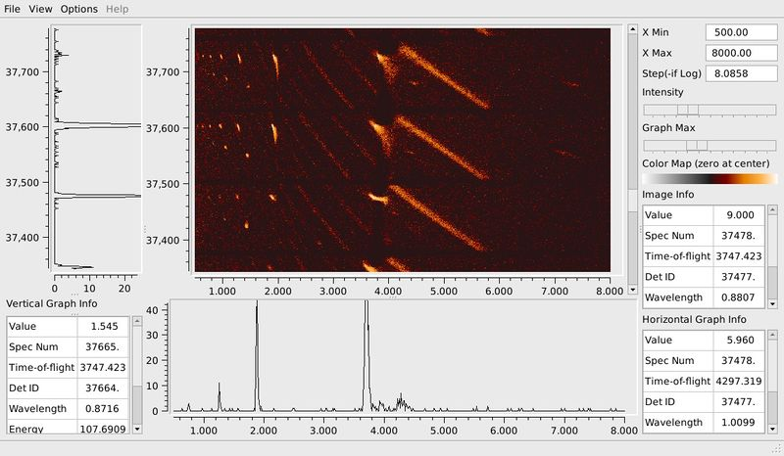
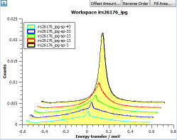
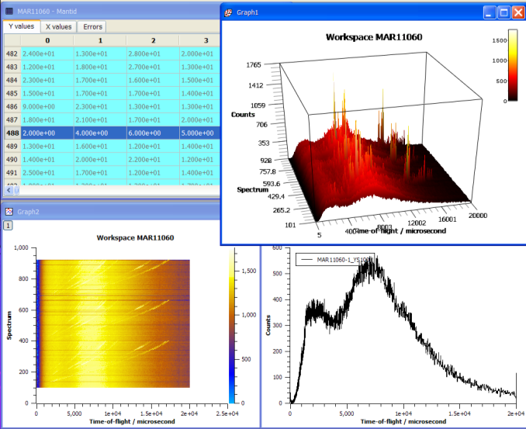
Our Graphs

Slide 18
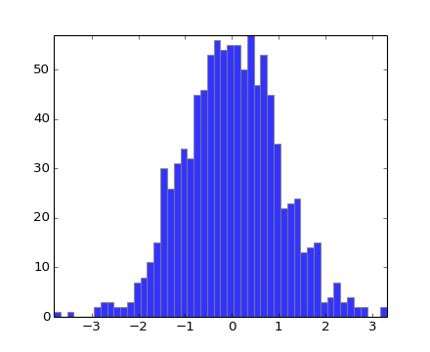
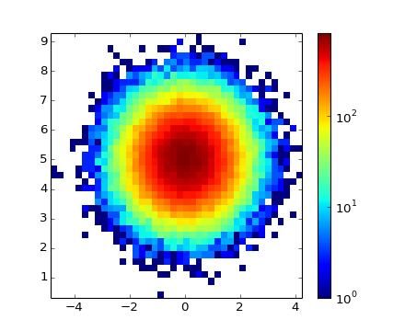
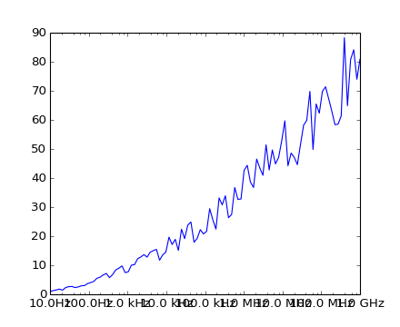
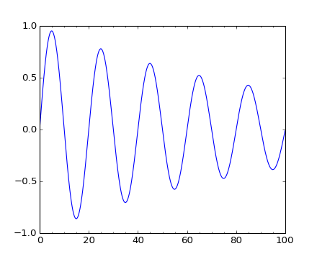
MatplotLib Graphs

Slide 19
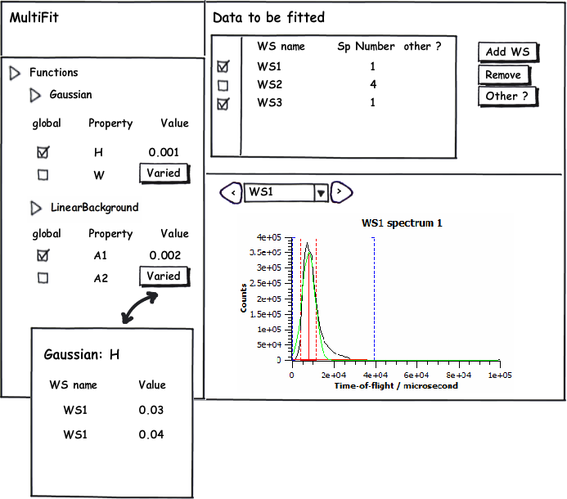
Multi data fitting gui

Slide 20

Future Plans

Slide 21
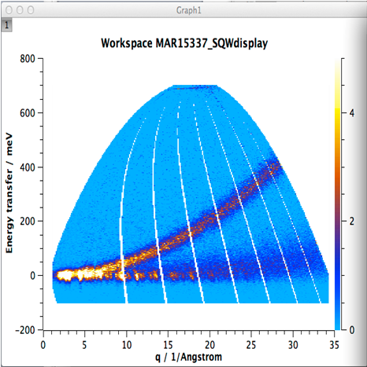
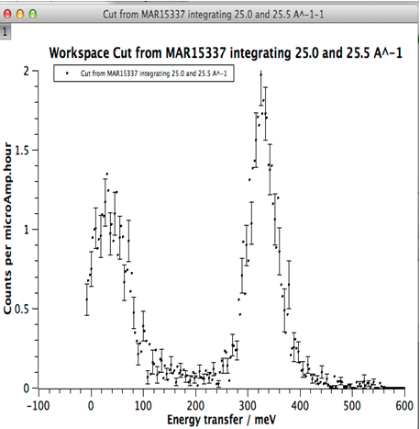
Intelligent Run Control
Define Region of interest
Define error bar criteria
BEGIN Run
Update from DAE & Reduce data to S(q,w)
Calculate statistic for ROI
Does statistic meet criteria
NO
YES
END run

Slide 22
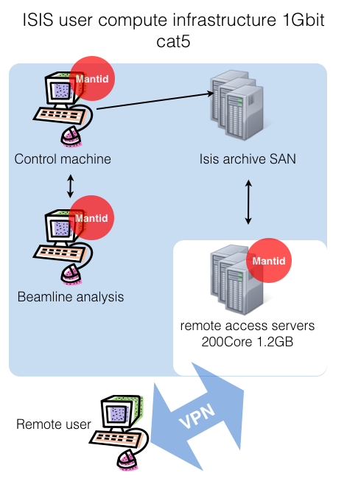
Current high Volume data
users need to:
Use SSH
Use VNC
Use VPN
federal ID and password
Also 3D views will not work well

Slide 23
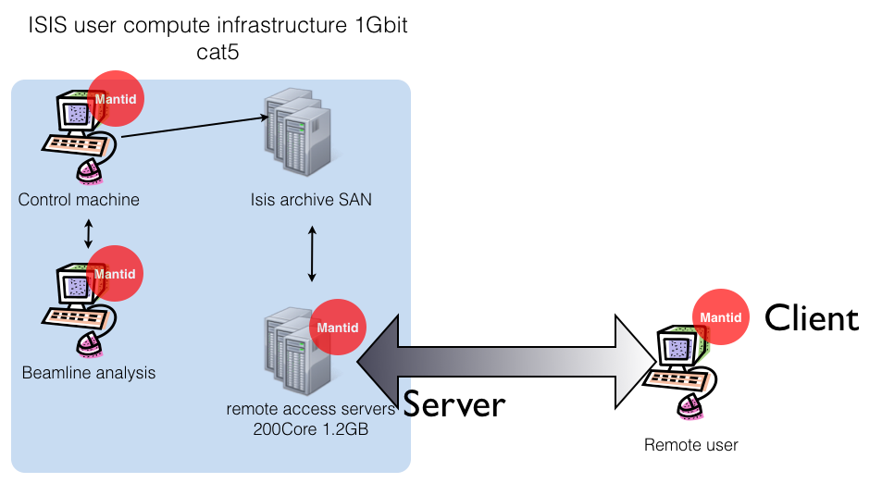
A possible solution

Slide 24
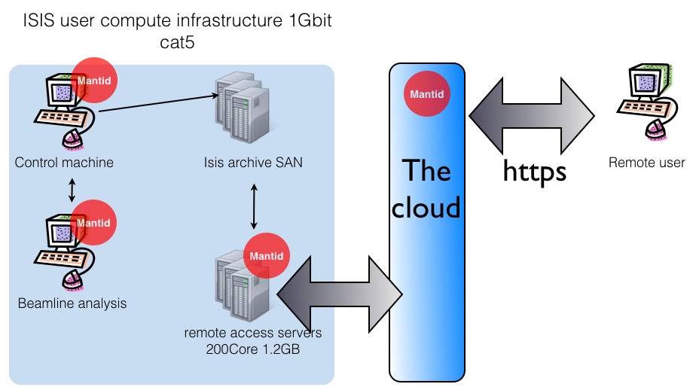
Web data access and reduction

Slide 25

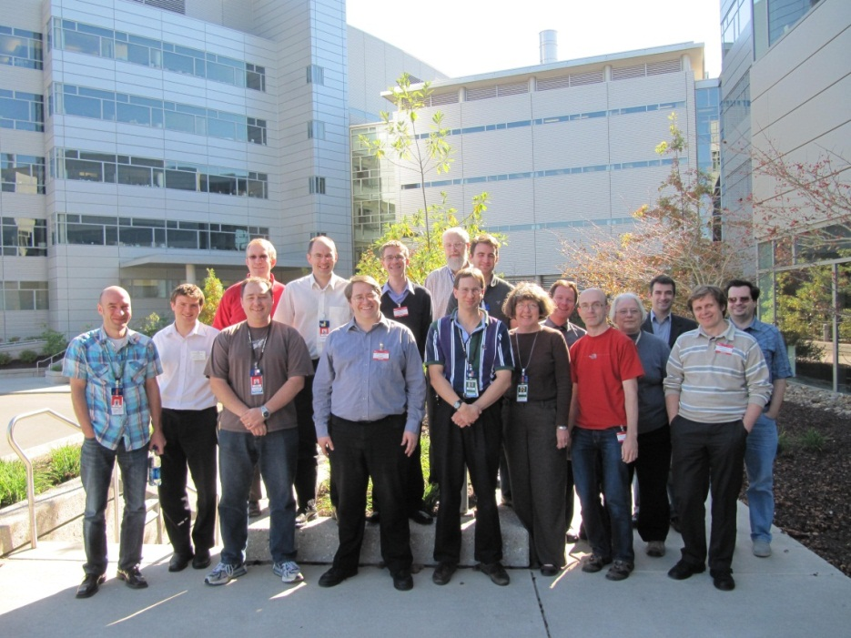

Further information
Project web page - www.mantidproject.org
VATES Poster - Poster Session B
Tessella - Stand 18
Many Thanks to the Project Sponsors
And the development team

